Slide 1


Daycare Project
Hanzhang Wang 001010009
Jiatian Li 001023304
Jinning Yang 001029162
Haojie Zhang 001029757

Slide 2
Detailed operating instructions
PART ONE

Slide 3

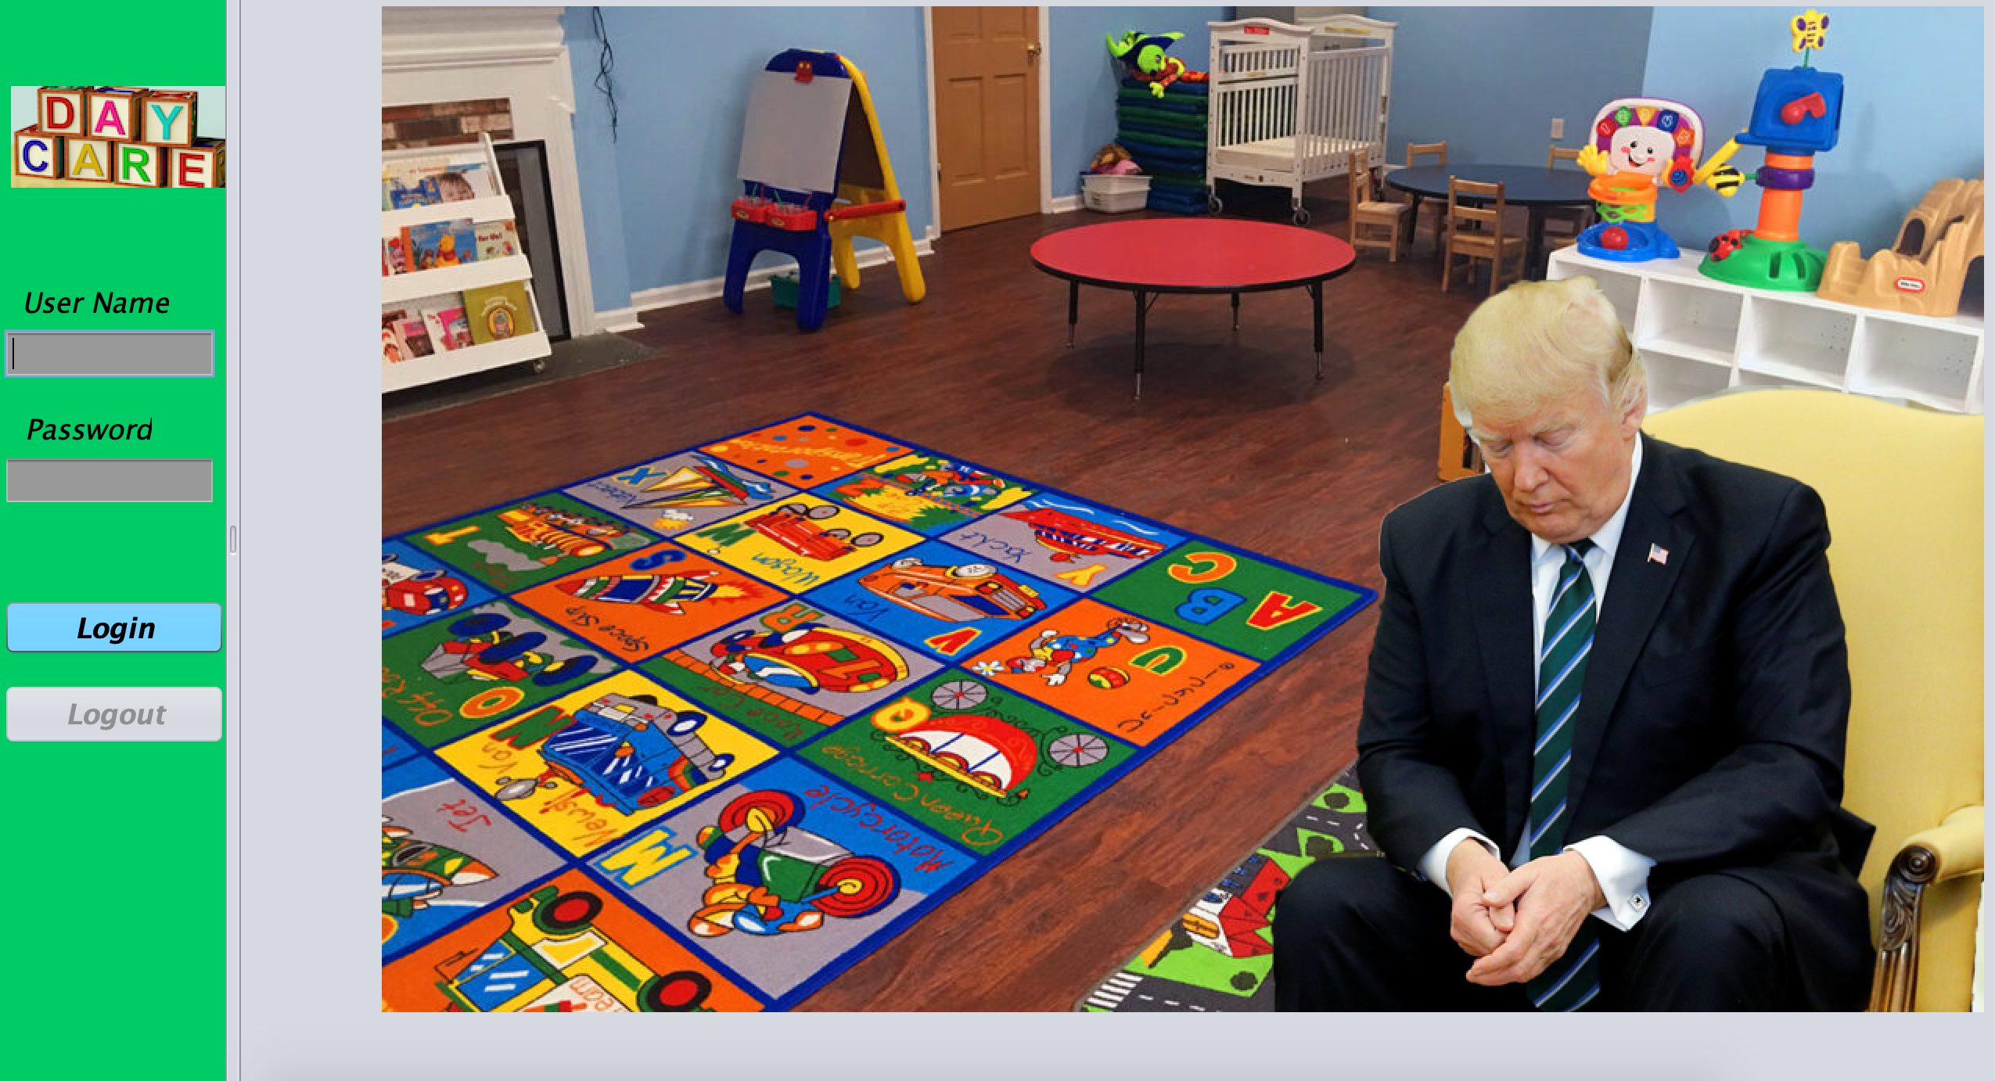

Key Screen Shot

Slide 4
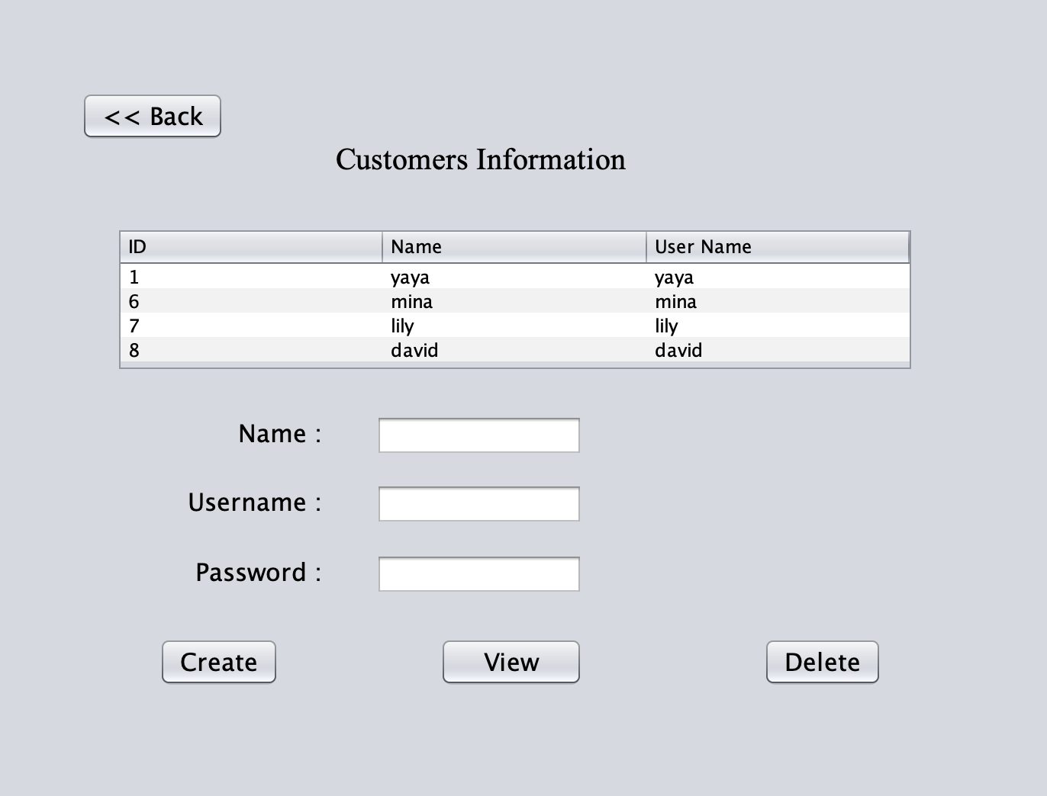
Key Screen Shot

Slide 5
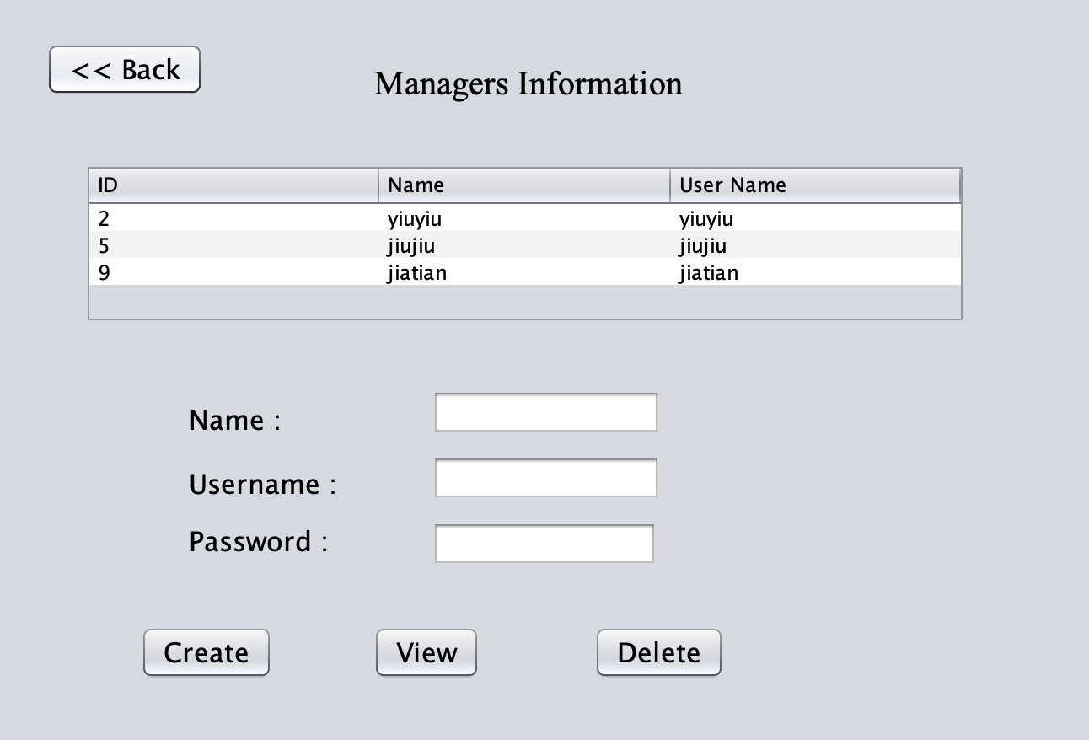
Key Screen Shot

Slide 6
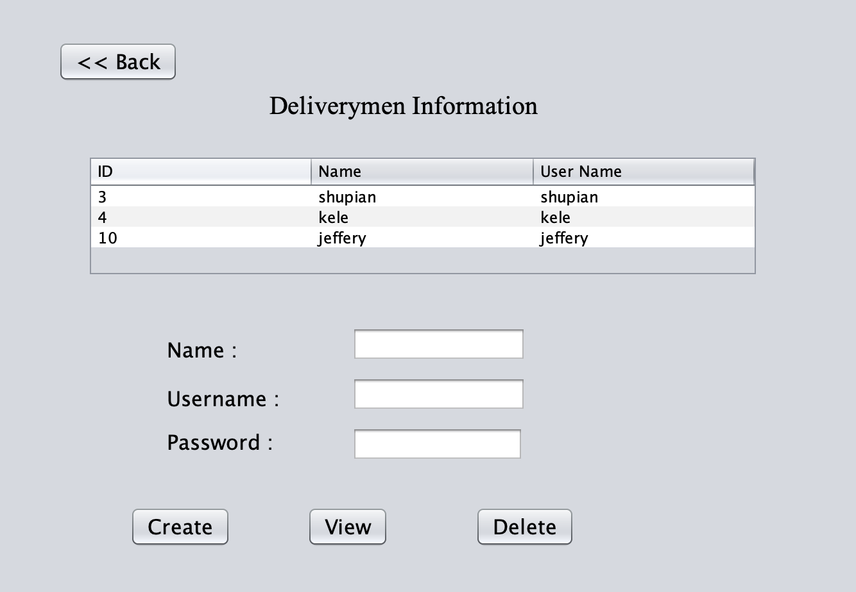
Key Screen Shot

Slide 7
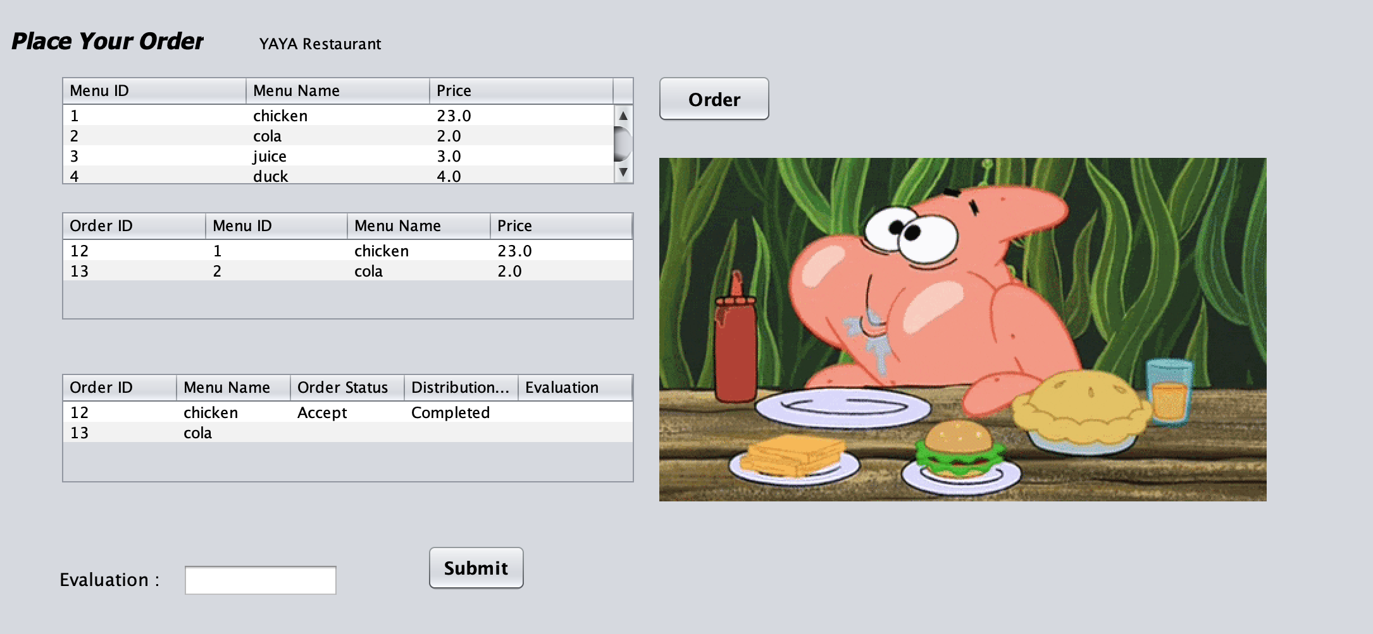
Key Screen Shot

Slide 8
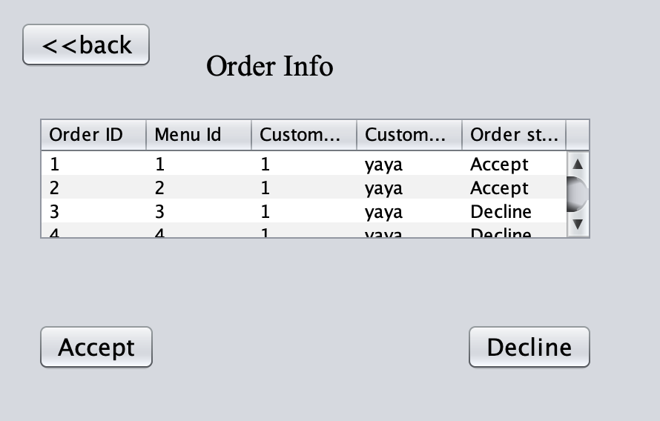
Key Screen Shot

Slide 9
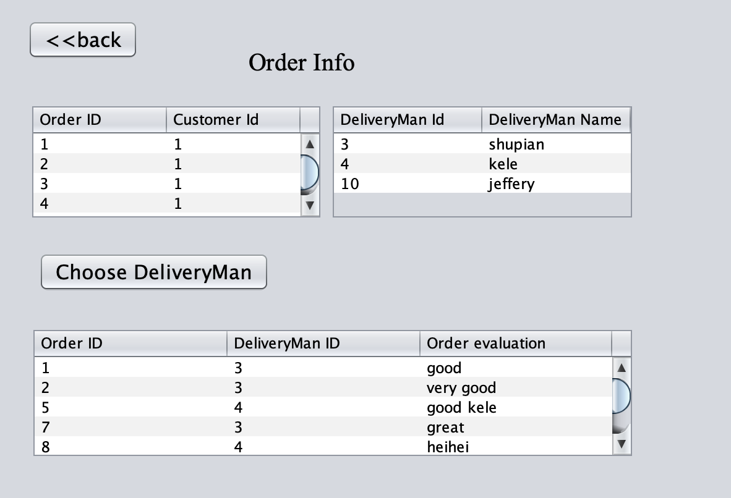
Key Screen Shot

Slide 10
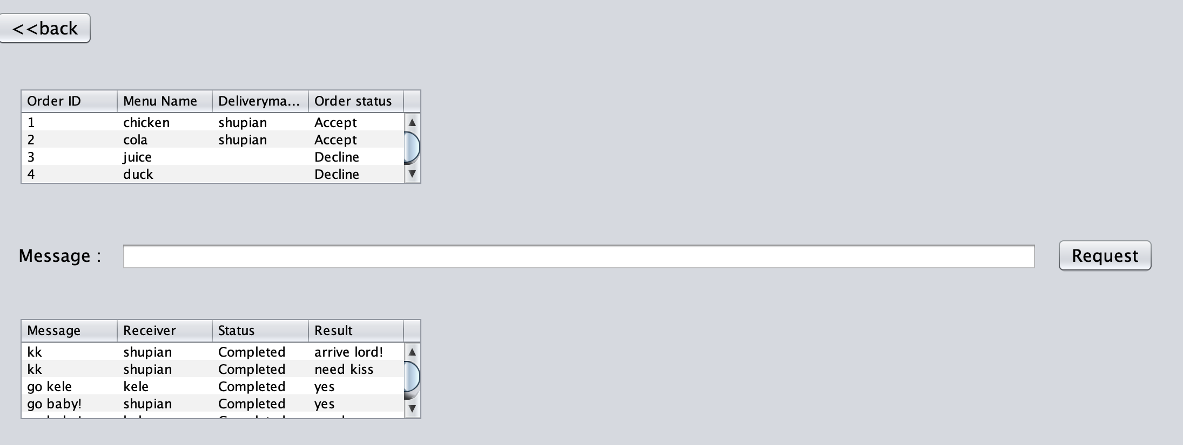
Key Screen Shot

Slide 11
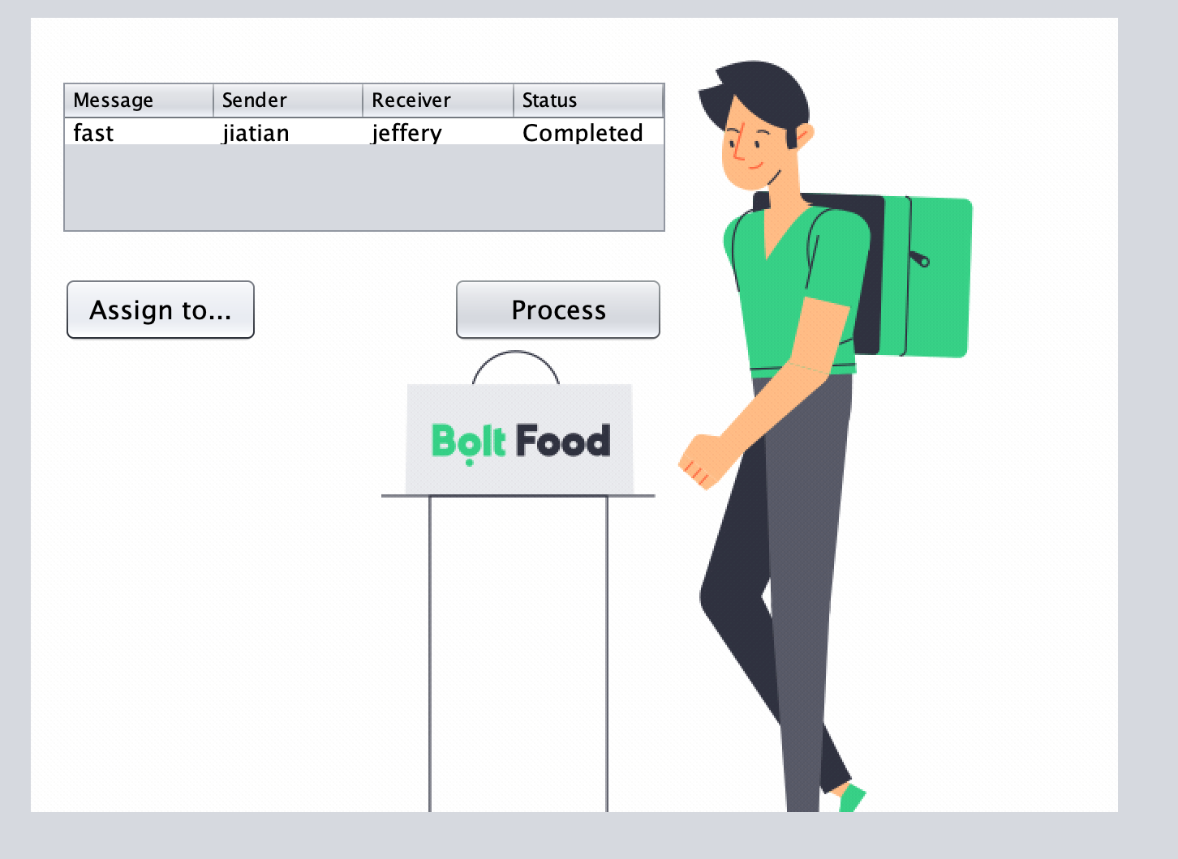
Key Screen Shot

Slide 12
List of technologies used
PART TWO

Slide 13
PART TWO
NetBeans
Eclipse
Structured Query Language(SQL)
Java Swing（JLabel、JButton、JTextField、JComboBox、JTable)
Unified Modeling Language (UML)
Comma-Separated Values (CSV)
Comparable Interface (Sort)

Slide 14
List of applied learning from CSYE6200
PART THREE

Slide 15
PART THREE
S.O.L.I.D. design principles
Single Responsibility Principle
Open-Closed Principle
Liskov Substitution Principle
Interface Segregation Principle
Dependency Inversion Principle

Slide 16
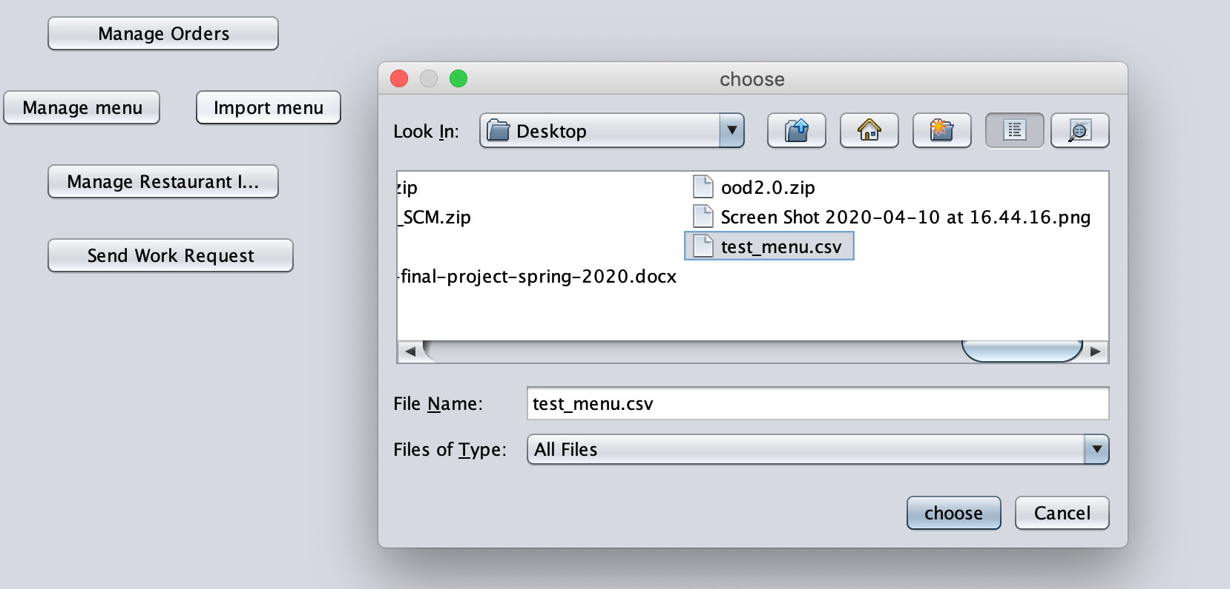
PART THREE
Read CSV

Slide 17
PART THREE
Swing
Lightweight components: Components from the javax.swing package, such as JButton and JLabel
II. Swing Hierarchy (java.awt.Component\java.awt.Container\JComponent)
III. Containers ( javax.swing.JFrame\javax.swing.JDialog)
IV. JTable
V. GUI Controls ( JTextField、JTextArea、JPasswordField、JRadio Button、JComboBox、JList、JSpinner、JSlider）

Slide 18
PART THREE
Object Oriented Principles
Abstraction: Access Modifiers\Java Interface\Java Abstract Class
Encapsulation: Data and Method Co-located together in same class
Inheritance: Super (Parent) class\Derived (child or sub) class
Polymorphism: Overridden methods-@Override

Slide 19
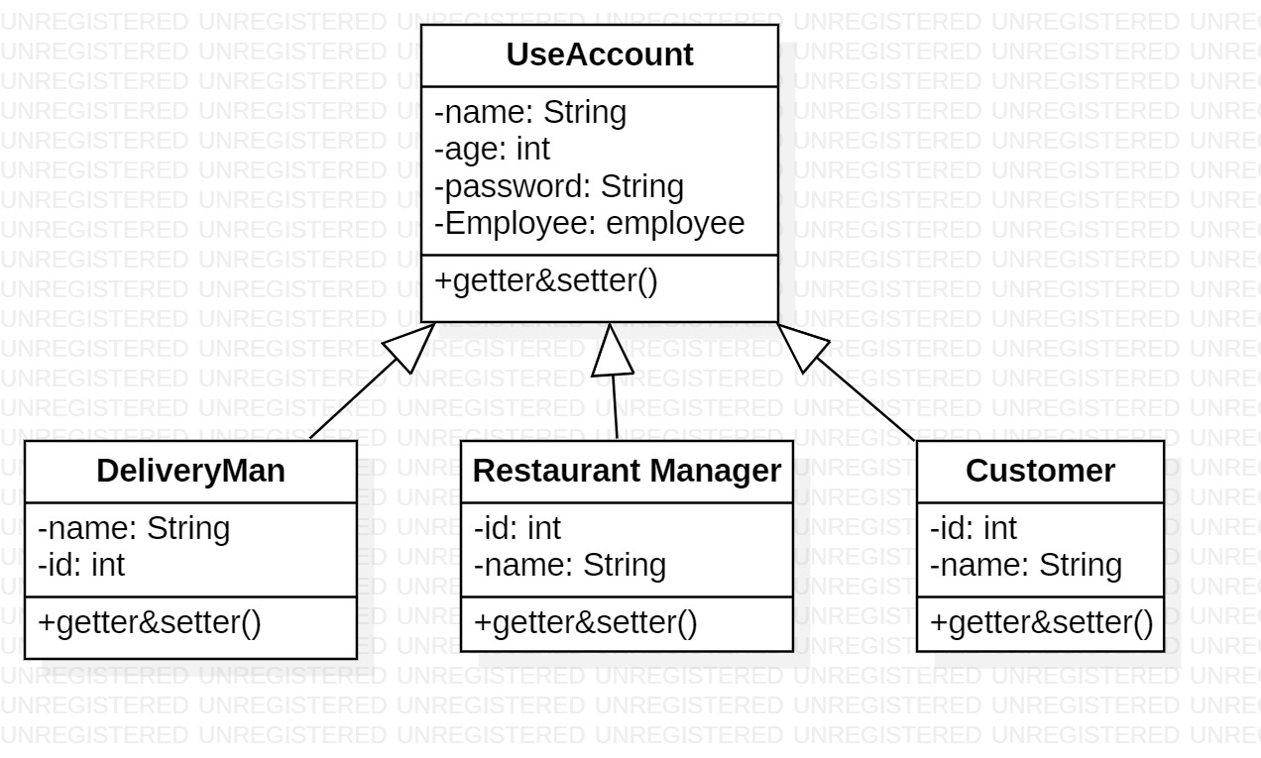
PART THREE
Unified Modeling Language
A picture language, diagrams\Relationship

Slide 20
List of applied learning outside of CSYE6200
PART FOUR

Slide 21
PART FOUR
Structured Query Language(SQL)
SQL is a standard language for storing, manipulating and retrieving data in databases
It can execute queries against a database, retrieve data from a database, insert\update\delate records in a database and create a new database....
RDBMS stands for Relational Database Management System

Slide 22
Lessons learned (pros and cons)
PART FIVE

Slide 23
PART FIVE
Benefits
The Object-Oriented Programing allows for parallel development. Each team mamber can work independently of project once the modular classes have been worked out. The modular classes are often reusable, and the coding is easier to maintain.
Swing is one of the powerful GUI module of java. It is easy to use, easy to implement,easy to develop then AWT

Slide 24
PART FIVE
Benefits
Strictly enforcing these SOLID and OOP Principle will greatly benefit any project and should be heavily considered along with other agile methodologies. This approach will lead to cleaner, more manageable code that can be easily unit tested, which in turn can allow for rapid development as it allows a more methodical approach.

Slide 25
PART THREE
Drawbacks
CSV allows to move most basic data only. Complex configurations cannot be imported and exported this way. And there is no standard way to represent binary data.

Slide 26
Possible future enhancements and features
PART SIX

Slide 27
PART THREE
We can add a SQL sever to make a web version. And also use a relational database management system-MySQL ,it would be more easier to manage the database system.
Build a recomdation system or a predicted model for the orders , based on the machinelearning technology. It will become more effectively and functionlity.

Slide 28
THANK YOU FOR WATCHING
Daycare project
Jinning Yang 001029162
Jiatian Wang 001023304
Hanzhang Wang 001010009
Haojie Zhang 001029757

